Slide 1


Slide 2

Application Of Machine Learning
In Health Care
PRESENTED BY:
Aashish Tharu Gamuwa
Q.ID: 23600004
SUBMITTED TO:
Dr. Ajay Kumar Sharma

Slide 3
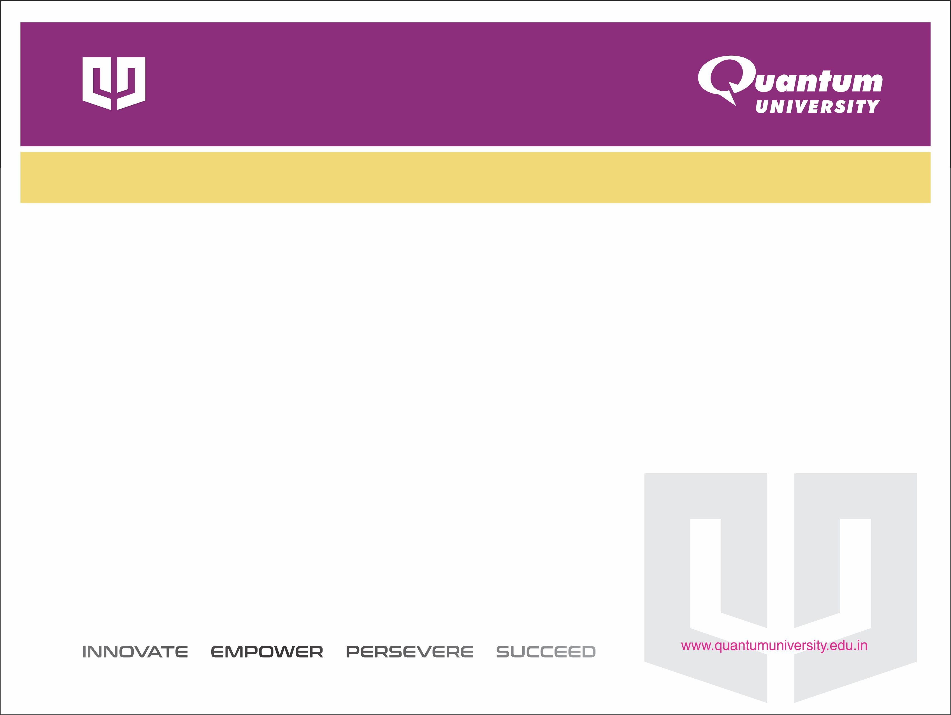

CONTENT:
Introduction to Machine Learning
Types of Machine Learning
ML Relevance in Healthcare
Application of Machine Learning in Health Care
Working with Live Model
Ethical & Legal Challenges
Future Directions
Summary

Slide 4


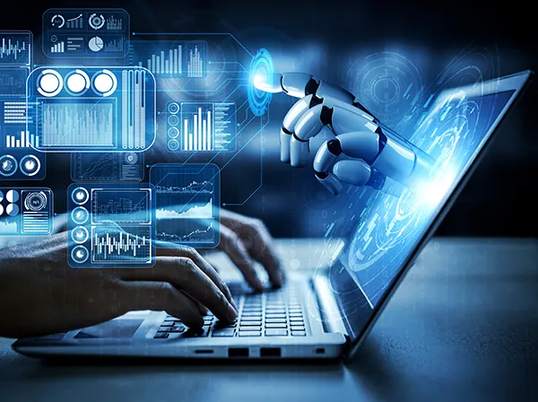
Introduction to Machine Learning
Machine Learning (ML) is a branch of Artificial Intelligence that enable computers to learn from data, identify patterns, and make decisions with minimal human intervention.
In healthcare, ML is used to analyse large and complex medical datasets to improve diagnosis, treatment, and patient outcomes.

Slide 5
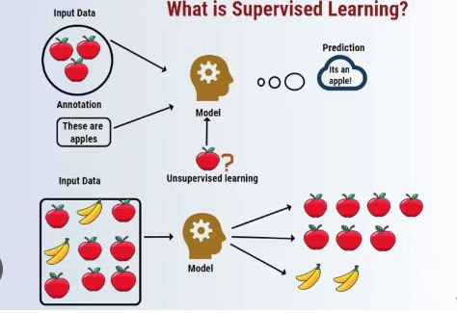
Types of Machine Learning
Machine Learning is generally categorized into three main types:
Supervised Learning
Learns from labelled data (input-output pairs).
Used in disease prediction and image classification.
Example: Predicting diabetes from patient records.

Slide 6
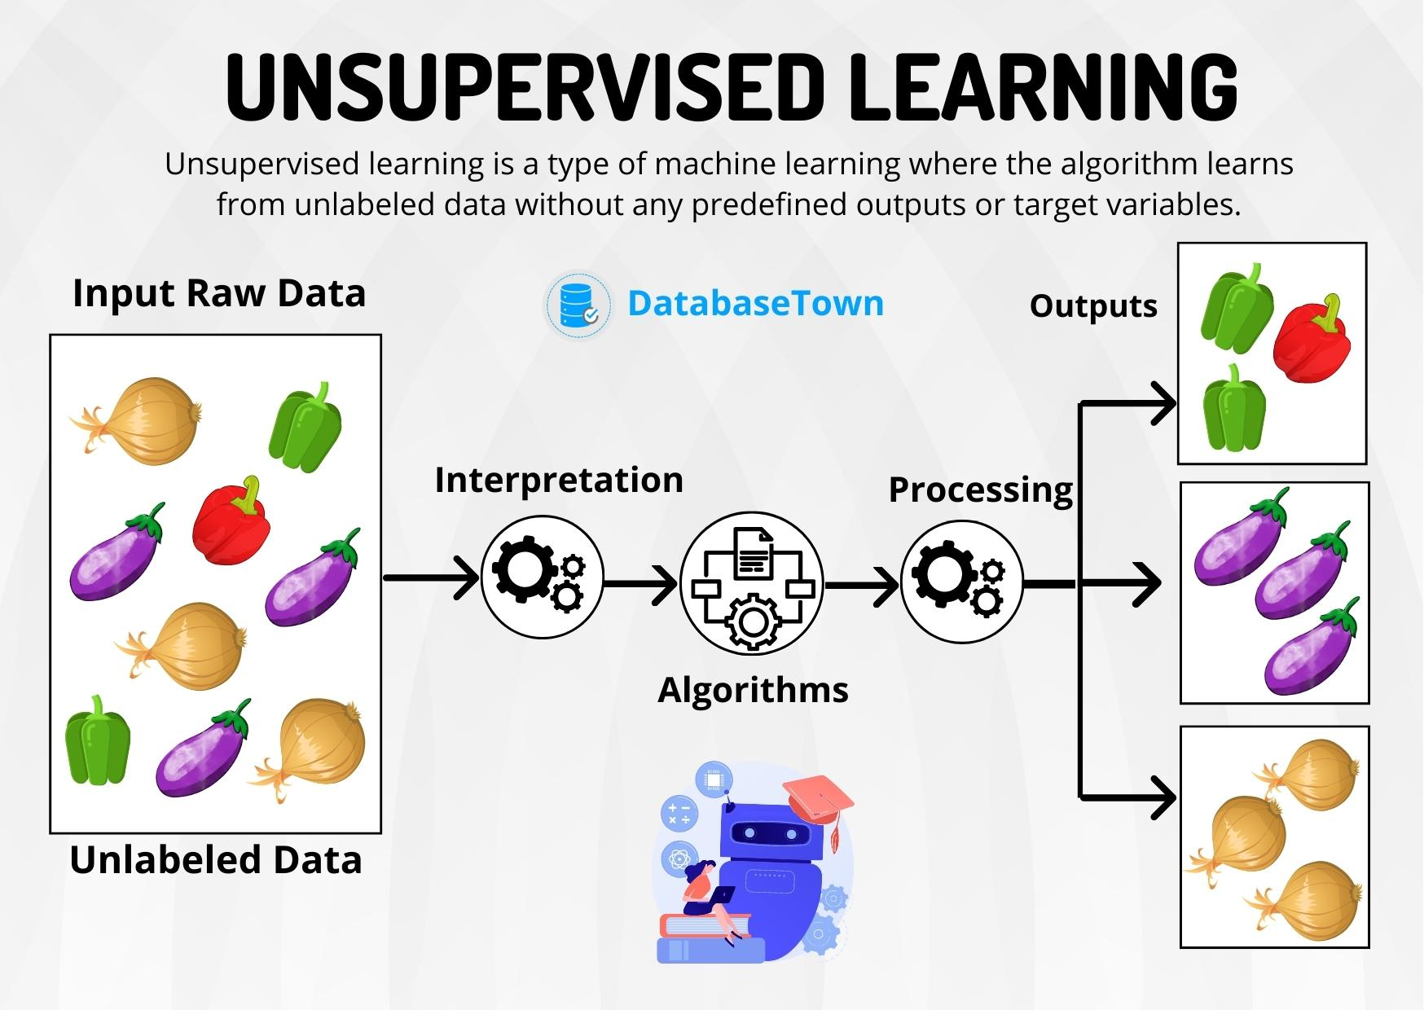
2. Unsupervised Learning
Finds patterns in unlabelled data.
Used for patient segmentation and anomaly detection.
Example: Grouping patients by disease risk levels.

Slide 7
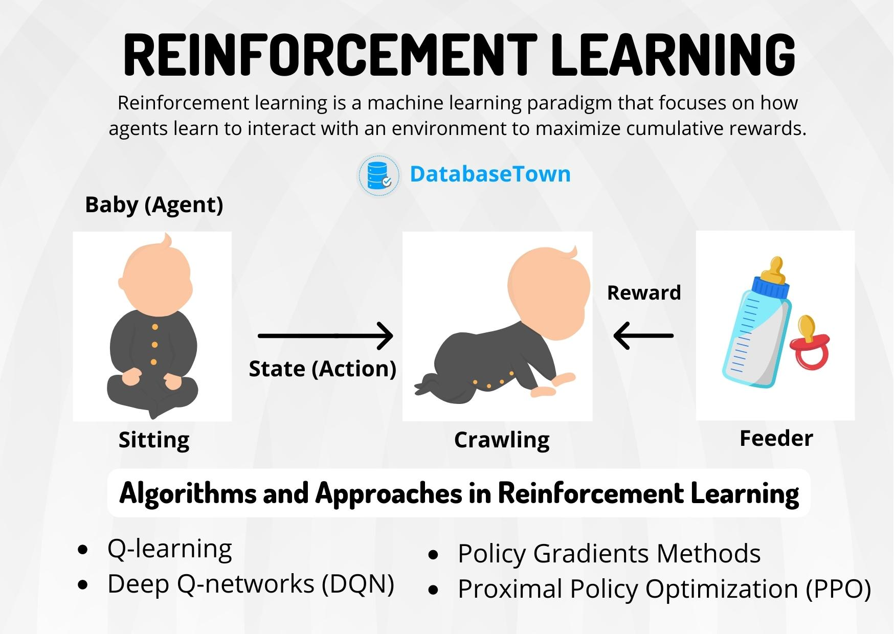
3. Reinforcement Learning
earns through trial and error using feedback from actions.
Used in personalized treatment plans and robotic surgeries.
Example: AI system adjusting medication dosages.

Slide 8
ML Relevance in Healthcare
Machine Learning is highly relevant in healthcare due to the massive amount of complex and diverse medical data generated daily.
Supports faster and more accurate disease diagnosis.
Predicts disease risks and patient outcomes.
Enables personalized treatment plans for individual patients.
Reduces human errors and enhances quality of care.

Slide 9
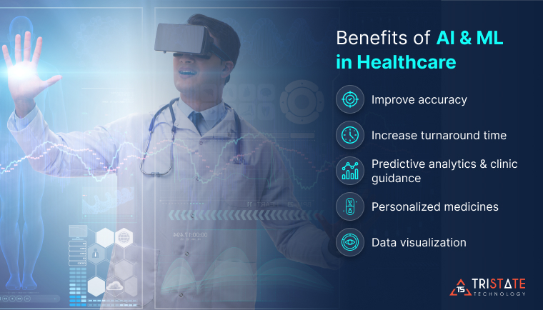
Application of Machine Learning in Health Care
Machine Learning helps improve healthcare by analysing medical data to support faster and more accurate diagnosis, personalized treatment, disease prediction, and better hospital management. It makes healthcare more efficient, reliable, and patient-focused, some applications are given below:

Slide 10
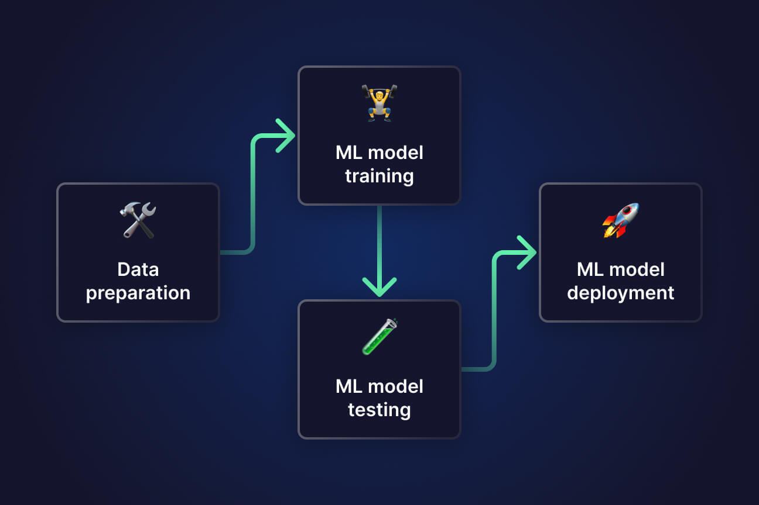
ML Pipeline in Healthcare
Data Collection
Data Preprocessing
Feature Selection/Engineering
Model Selection & Training
Model Evaluation
Deployment
Monitoring & Maintenance

Slide 11
Applications:
Disease Detection and Diagnosis
Radiology and Medical Imaging
Drug Discovery and Development
Personalized & Precision Medicine
Operational Efficiency in Hospitals
ML in Remote Monitoring

Slide 12
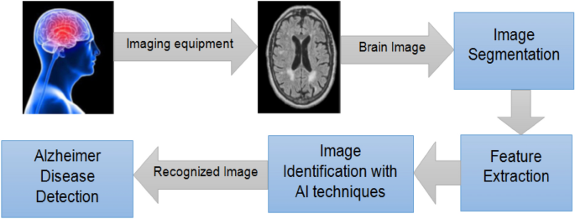
Disease Detection and Diagnosis

Slide 13
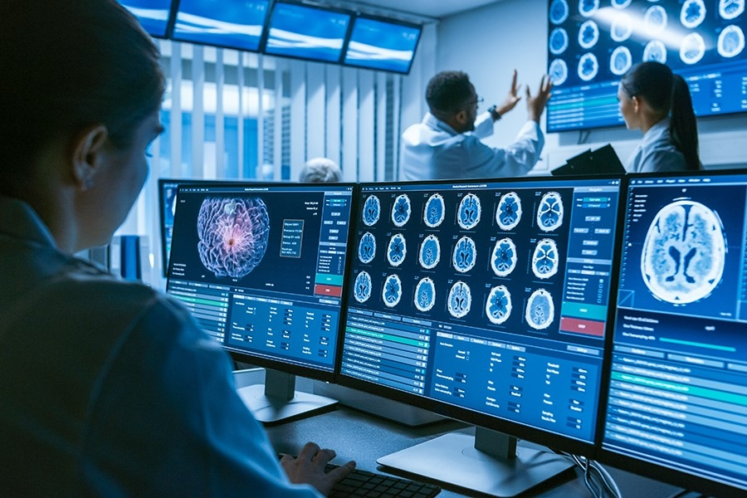
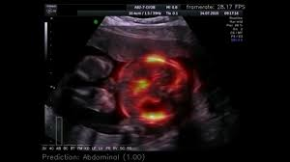
Radiology and Medical Imaging

Slide 14
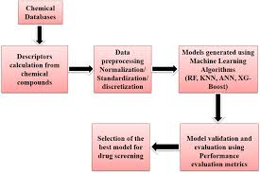
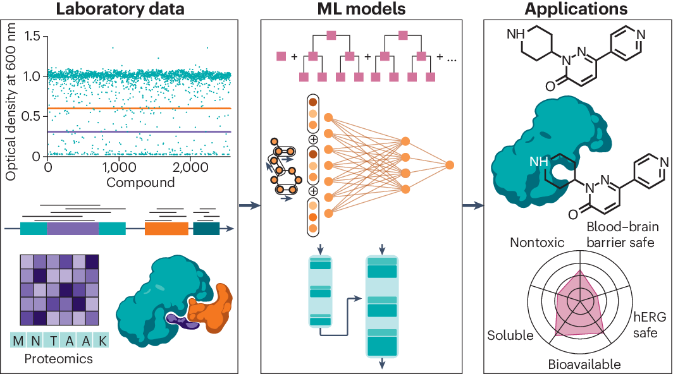
Drug Discovery and Development

Slide 15
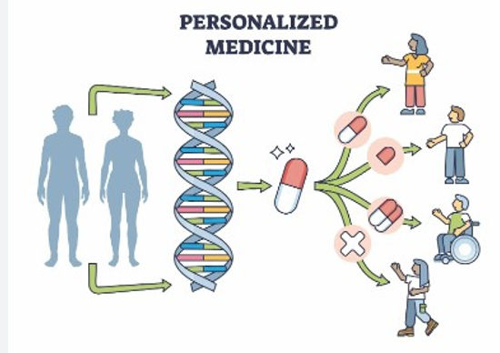
Personalized & Precision Medicine

Slide 16
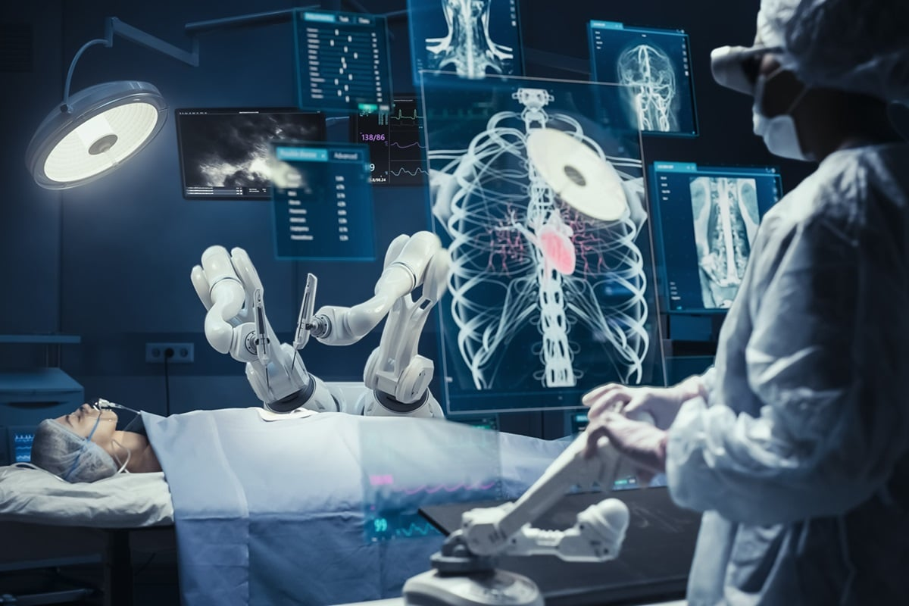
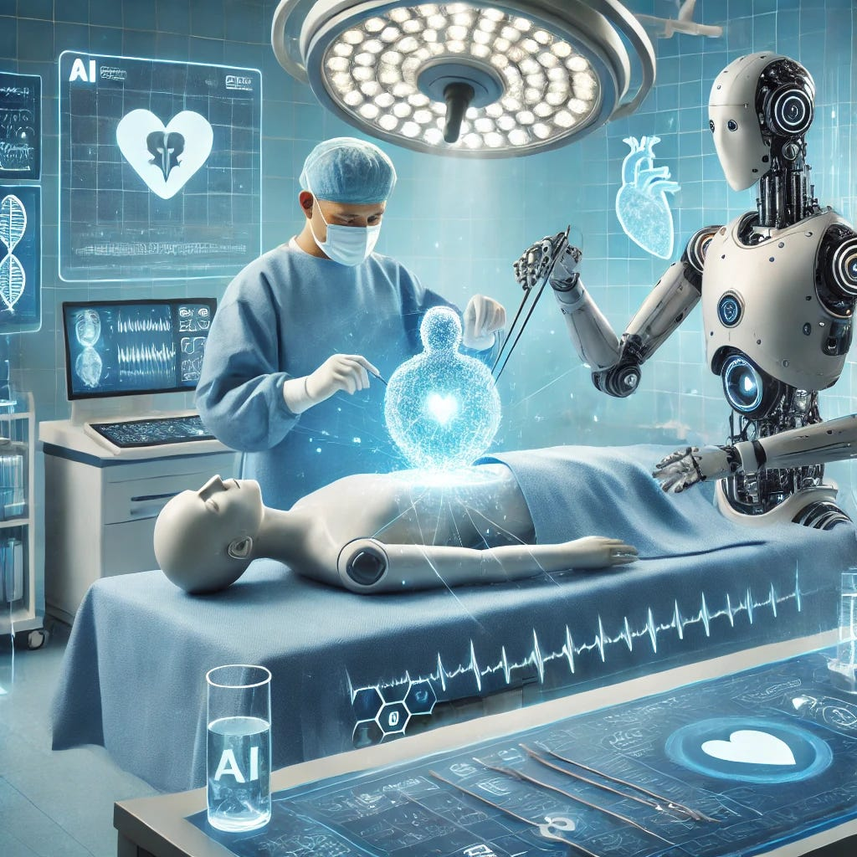
Operational Efficiency in Hospitals

Slide 17
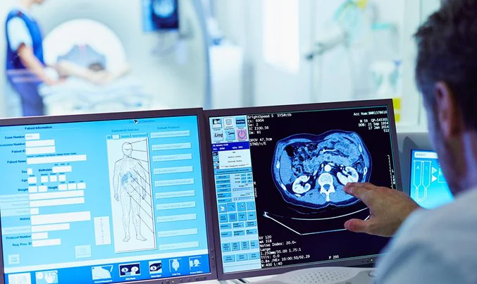
ML in Remote Monitoring

Slide 18
Working with Live Model
Multiple Disease Prediction
System
Prepaired By: Aashish Tharu Gamuwa

Slide 19
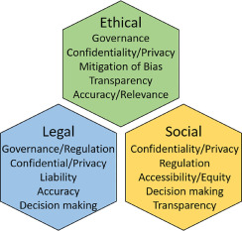
Ethical & Legal Challenges
Data Privacy & Security
Legal & Regulatory Compliance (FDA)
Transparency & Explainability
Bias & Fairness
Clinical Reliability & Safety
Ethical Responsibility & Decision-Making

Slide 20
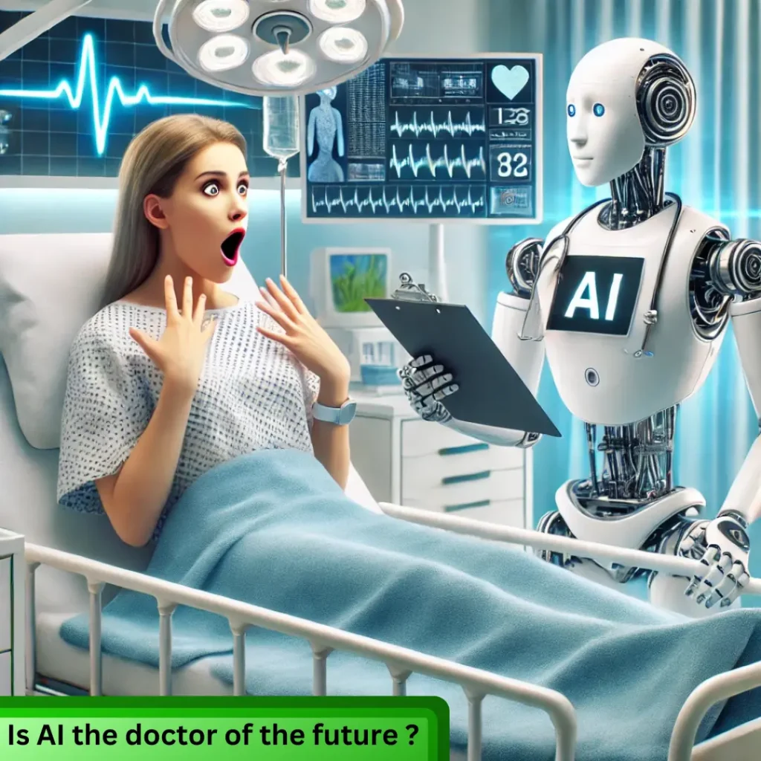
IS AI THE DOCTOR OF THE FUTURE

Slide 21
Future Directions
Advanced Learning Techniques
Personalized & Precision Medicine
Multimodal & Real-Time AI
Smart Hospital Systems
Integration with Other Technologies
Ethical, Accessible, and Global AI

Slide 22
Summary
Machine Learning is revolutionizing healthcare by enabling faster, more accurate, and data-driven decisions. From disease diagnosis to personalized treatment and operational efficiency, ML applications are improving patient outcomes and transforming clinical workflows. However, challenges like data privacy, bias, and ethical concerns must be addressed. With continued innovation and responsible use, ML holds immense promise to make healthcare more precise, accessible, and intelligent in the future.

Slide 23
THANK YOU

